Slide 1


Slide 2
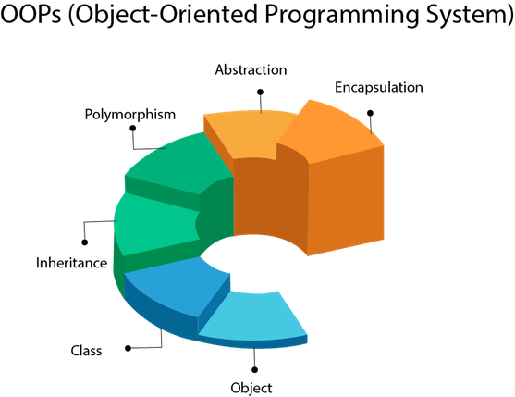

Slide 3
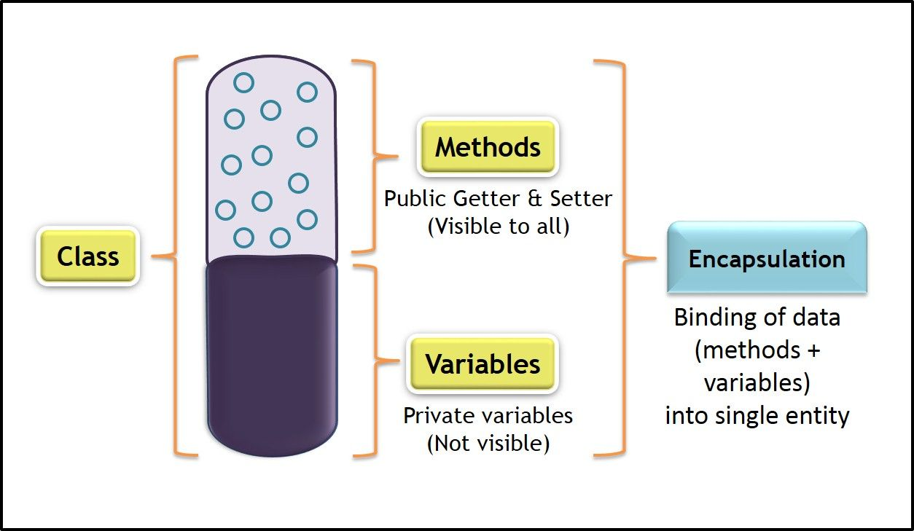

Slide 4
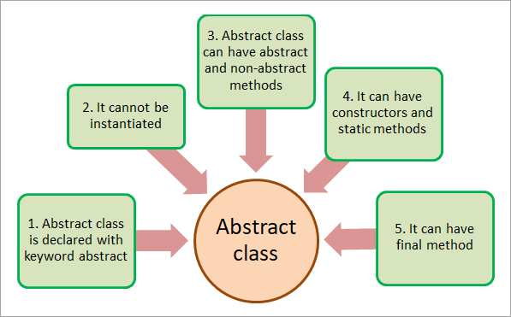

Slide 5
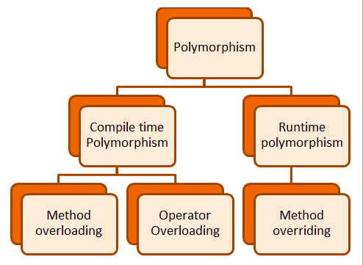

Slide 6


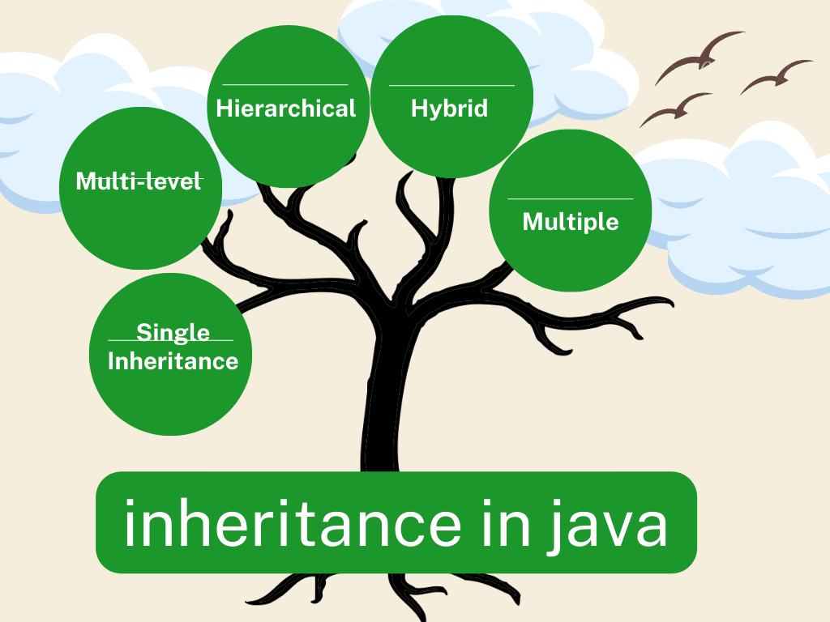



Inheritence:-Inheritance is a fundamental concept of Object-Oriented Programming (OOP). It is a mechanism by which an object acquires the properties and behaviors of another object. The object that acquires the properties is called the subclass and the object whose properties are acquired is called the superclass.

Slide 7
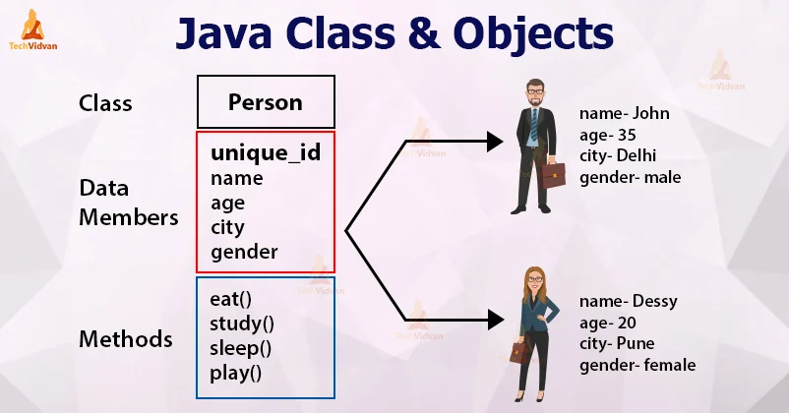
Class
Collection of objects is called class. It is a logical entity.
A class can also be defined as a blueprint from which you can create an individual object. Class doesn't consume any space.
Object
Any entity that has state and behavior is known as an object. For example, a chair, pen, table, keyboard, bike, etc. It can be physical or logical.

Slide 8
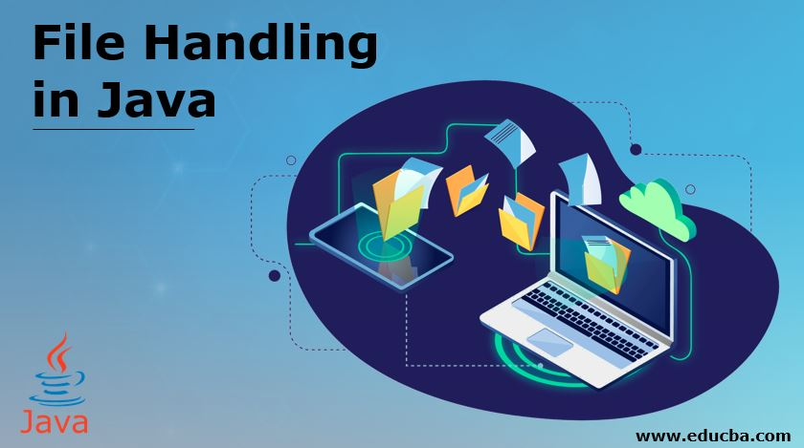

Slide 9
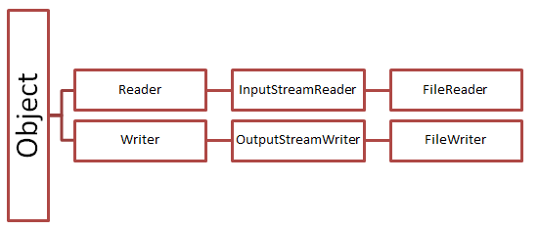
What is File Handling in Java?
Java programming language is very popular among programming languages. It gives strong support to different functionalities such as databases, sockets, etc. File Handling concept is very important in java to do different tasks on documents like write, read, etc.
It is used for creating, updating, reading and removing the documents, that are saved in a document system. The file class is present in java.io.package. It allows working with various patterns of documents.
To use this class, first, we have to create an object and mention the report name. To perform Input-output operation on a report, this programming language uses the stream concept.

Slide 10
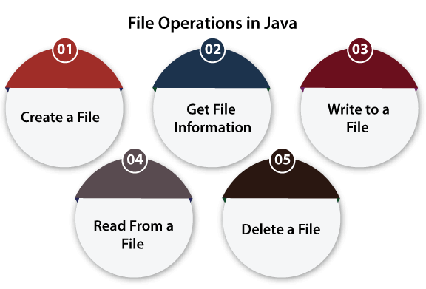

Slide 11
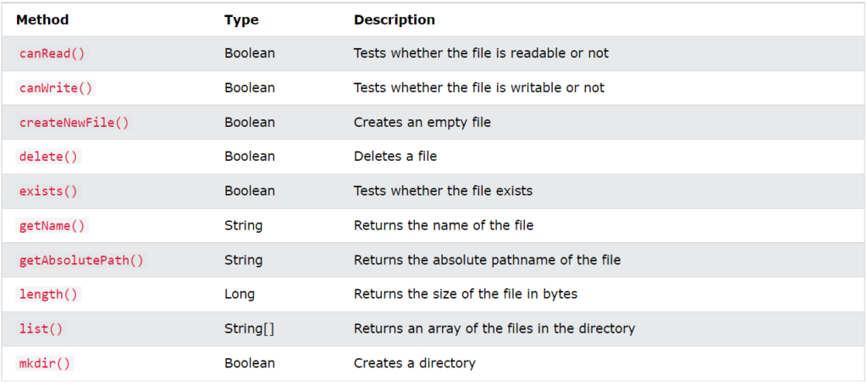
Java file class method

